Slide 1
SWE482 final presentation
By
Sultan Alenzi
Abdulmalek Shreim
Khalid Alharbi
Abdulmjeed Alromaih
Abdulrahman Alshabani

Slide 2
Agenda
Idea
audience
prototype
Video of prototype

Slide 3
The idea
Mobile-based application
Cover Universities aspects
provide services for high school students
news functionality
apply for university
provide scheduler for date appliement

Slide 4
Audience
High school students
Any one interest to get the universities news in one place
18 : 25 age
Focusing on usability by offering simple design to make any one able to use the system.

Slide 5
Prototype
Registration and login page
recover password layout
Home page
Apply for university page
Search for university page
News page
Edit profile page

Slide 6
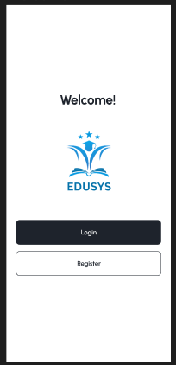
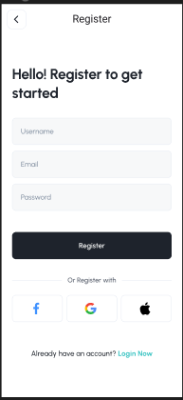
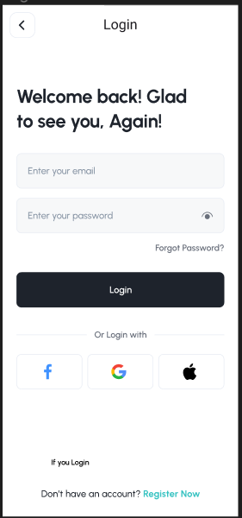
Registration and login page

Slide 7
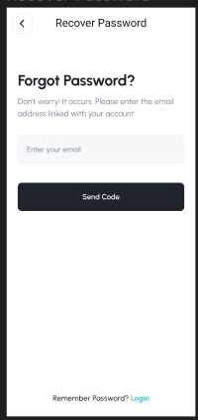
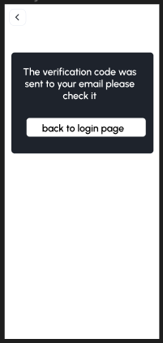
Forget password page

Slide 8
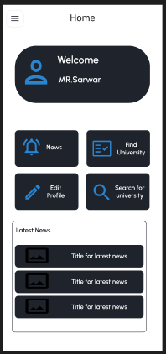
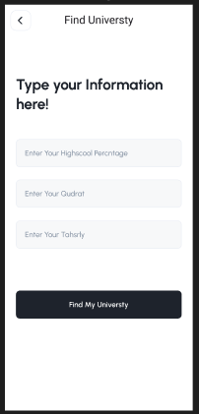
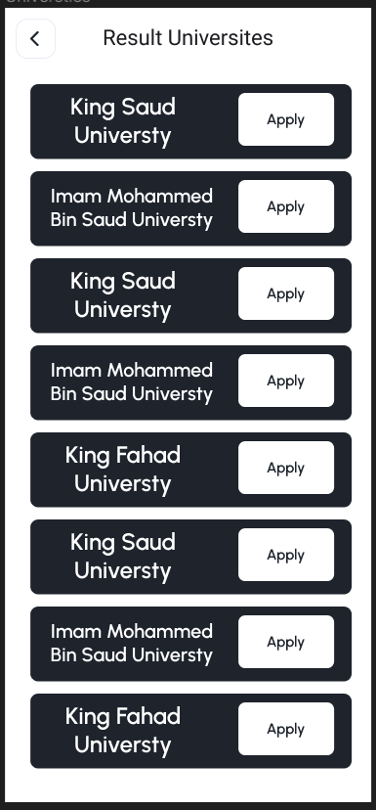
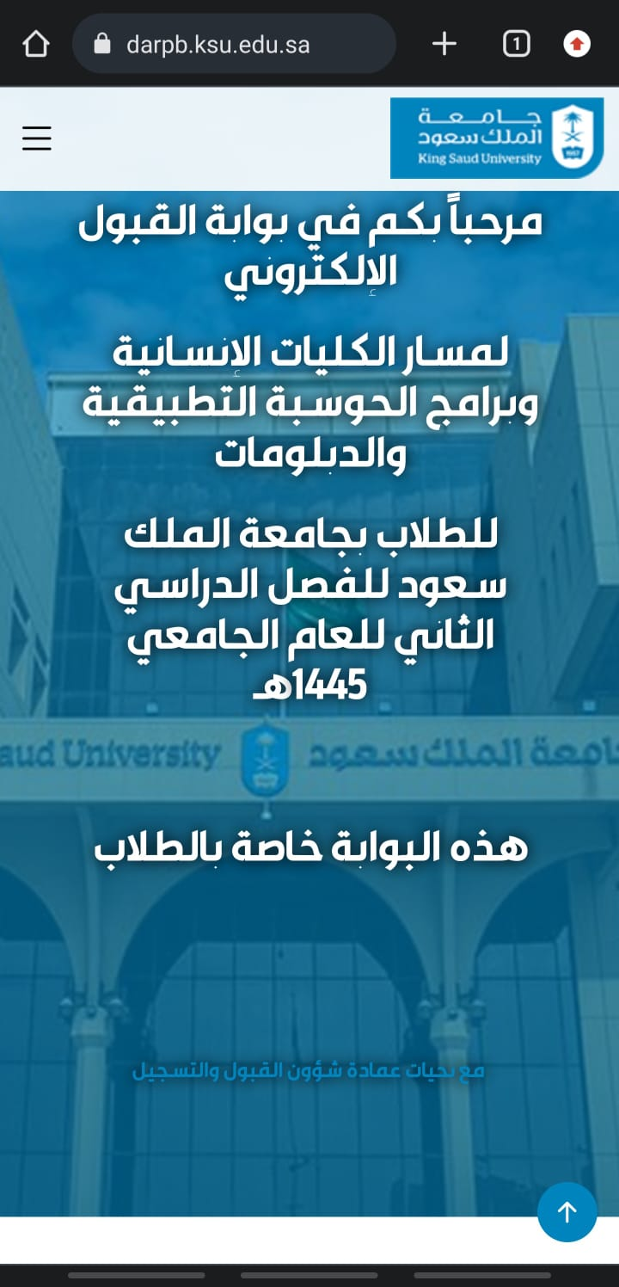
Find university page

Slide 9
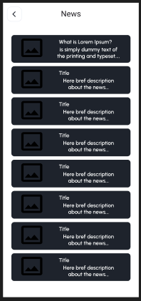
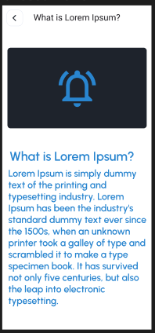
News page

Slide 10
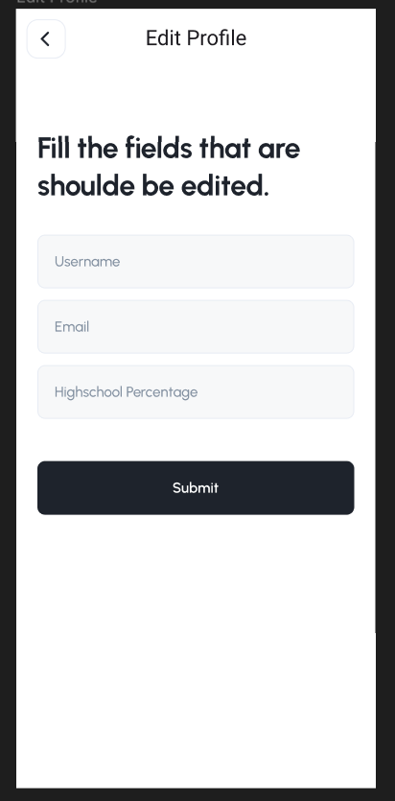
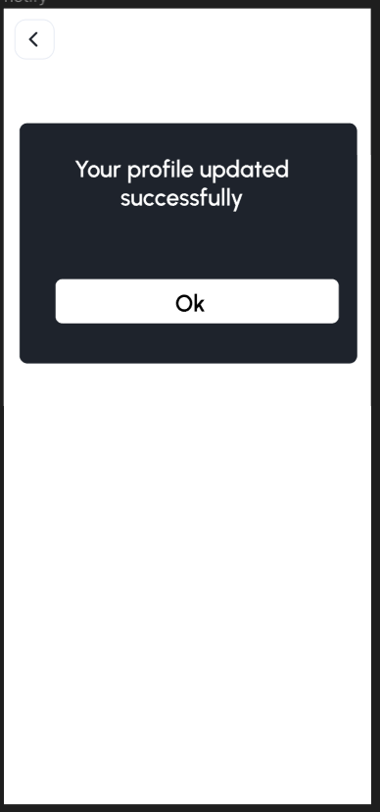
Edit profile page

Slide 11
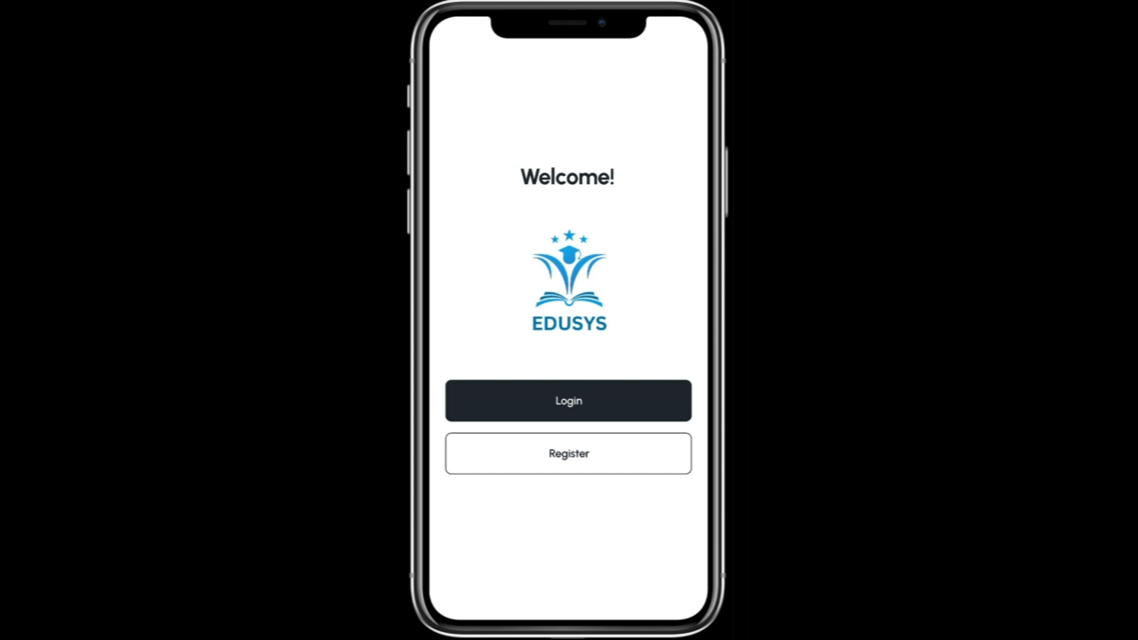
Prototype Video

